Slide 1
0222 전반부
김현우

Slide 2
목차
1) Curse of Dimensionality
2) Principal Component Analysis
3) Principal Component Analysis Example
4) Linear Discriminant Analysis
5) Singular Value Decomposition, Non-Negative Matrix Factorization
6) Example

Slide 3
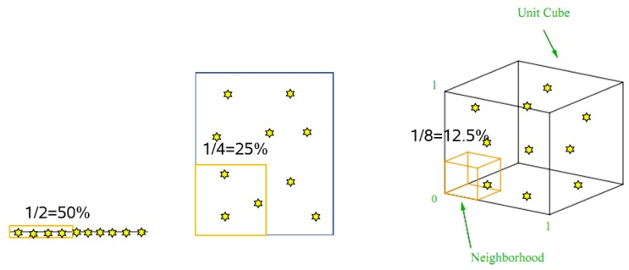
Curse of Dimensionality

Slide 4
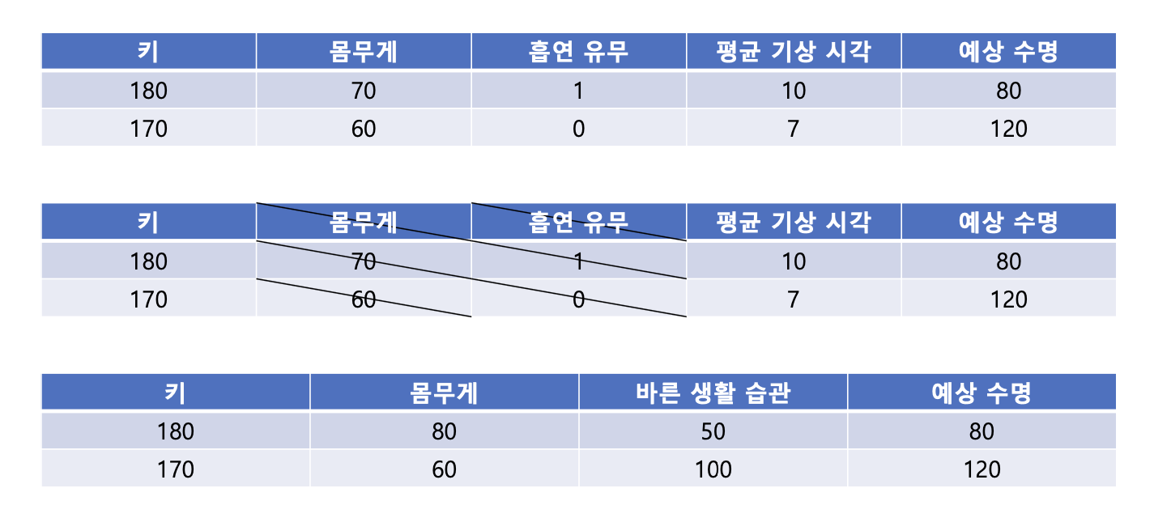
Curse of Dimensionality
Feature Selection vs Feature Extraction

Slide 5
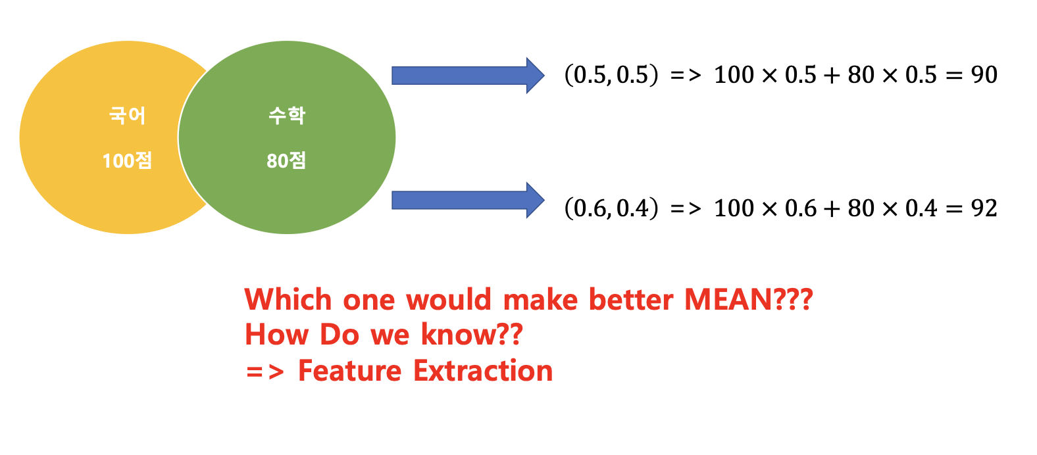
Principal Component Analysis

Slide 6
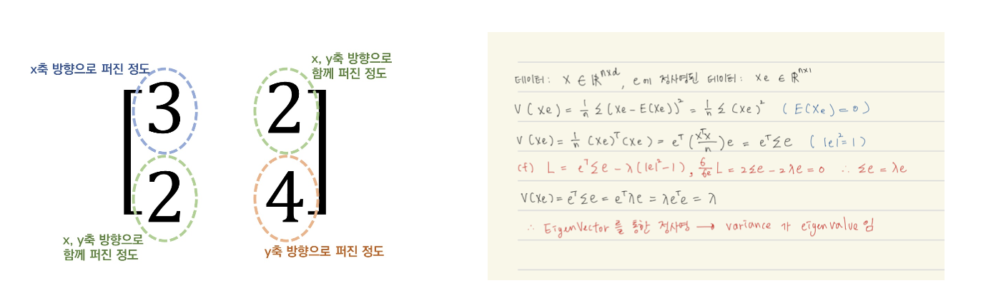
Principal Component Analysis

Slide 7
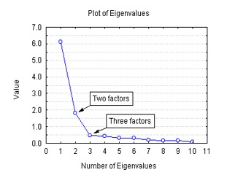
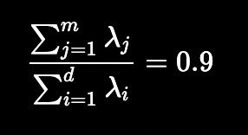
Principal Component Analysis

Slide 8
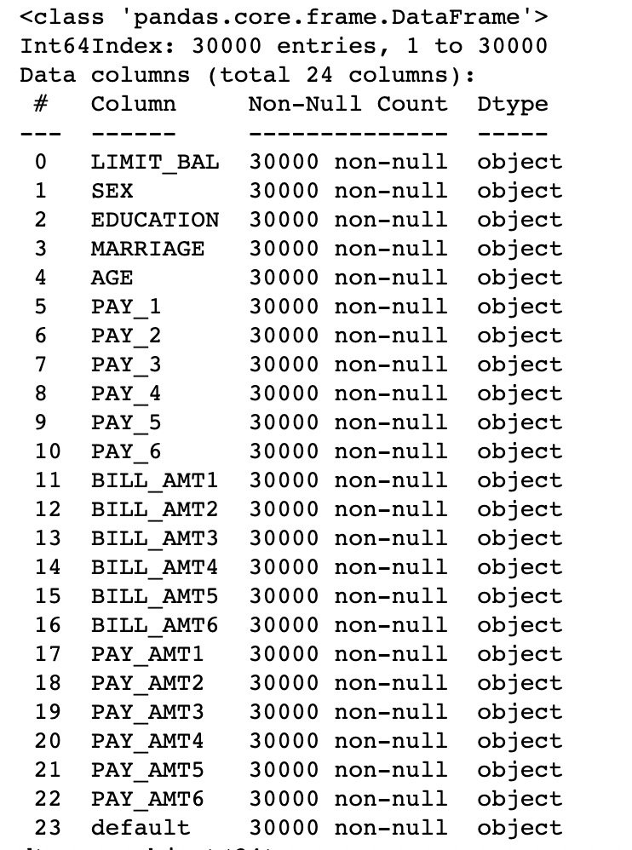
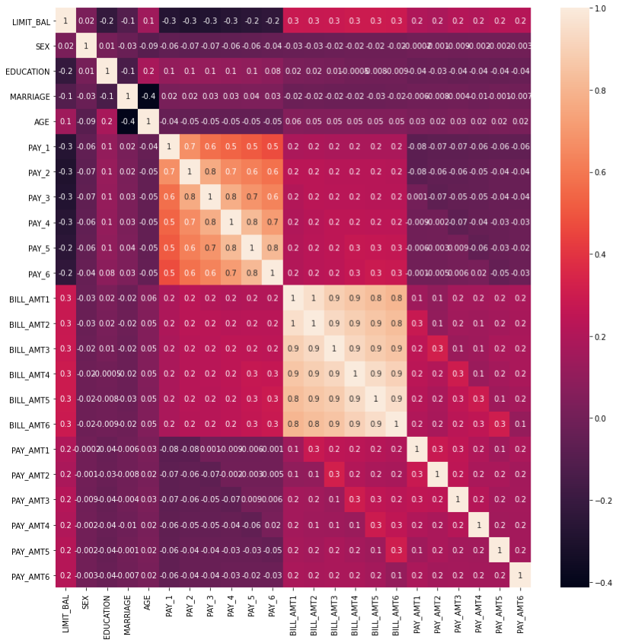
Principal Component Analysis Example

Slide 9
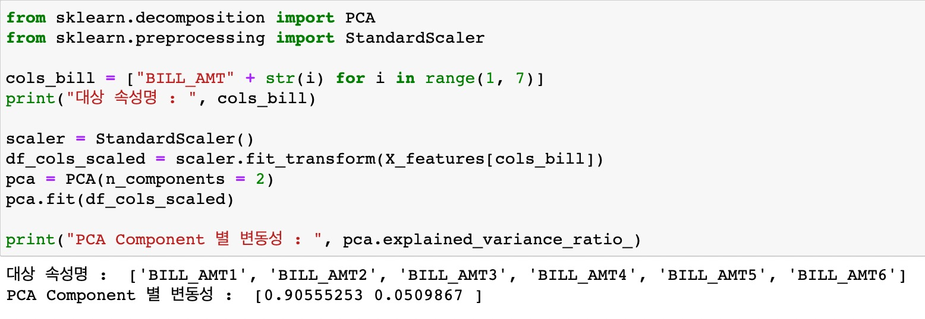
Principal Component Analysis Example

Slide 10
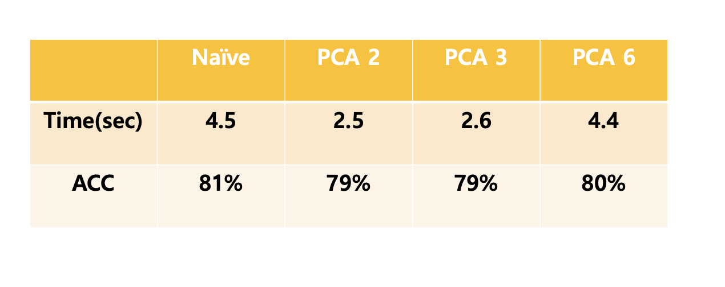
Principal Component Analysis Example

Slide 11
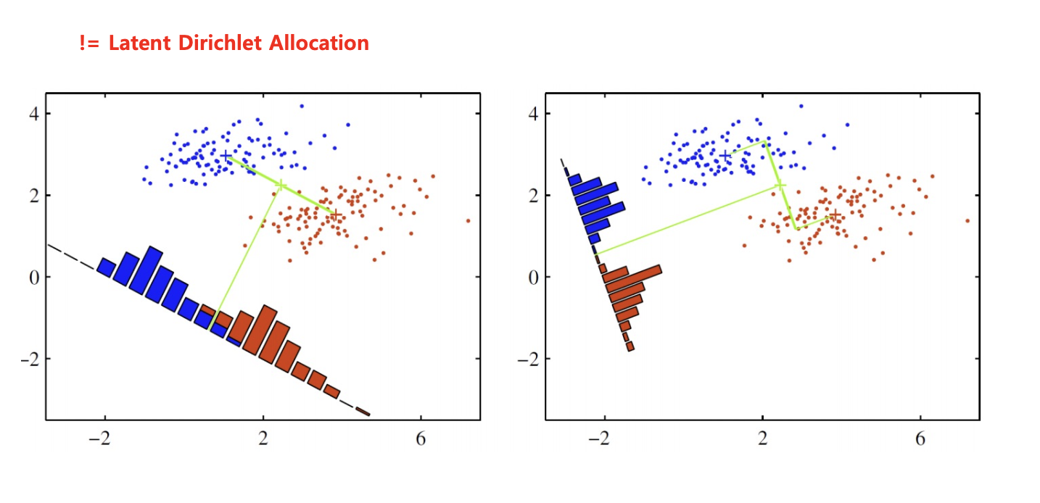
Linear Discriminant Analysis

Slide 12
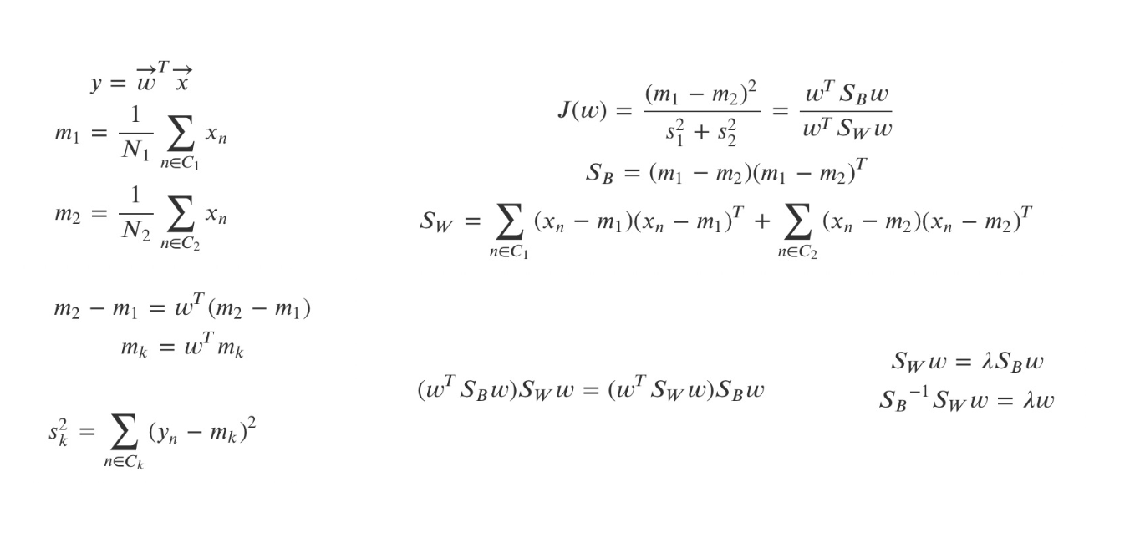
Linear Discriminant Analysis

Slide 13
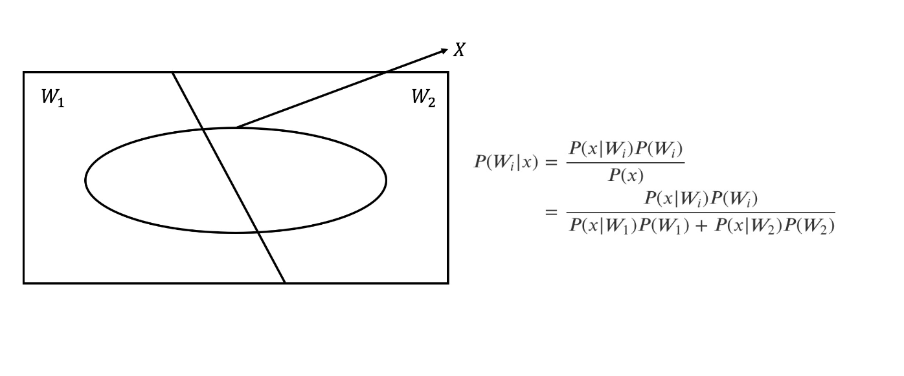
Linear Discriminant Analysis

Slide 14

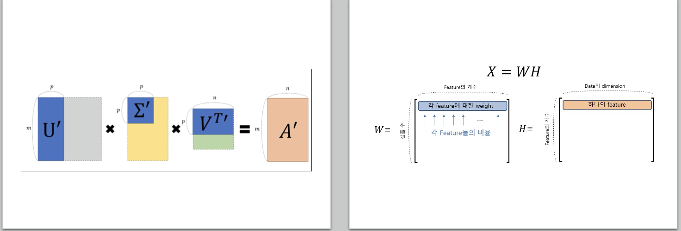
Singular Value Decomposition, Non-Negative Matrix Factorization

Slide 15
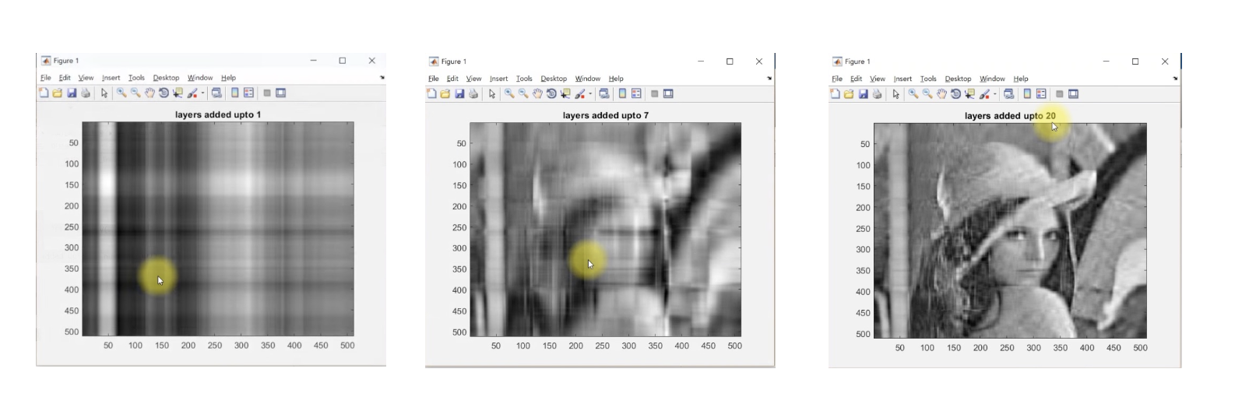
Singular Value Decomposition, Non-Negative Matrix Factorization

Slide 16
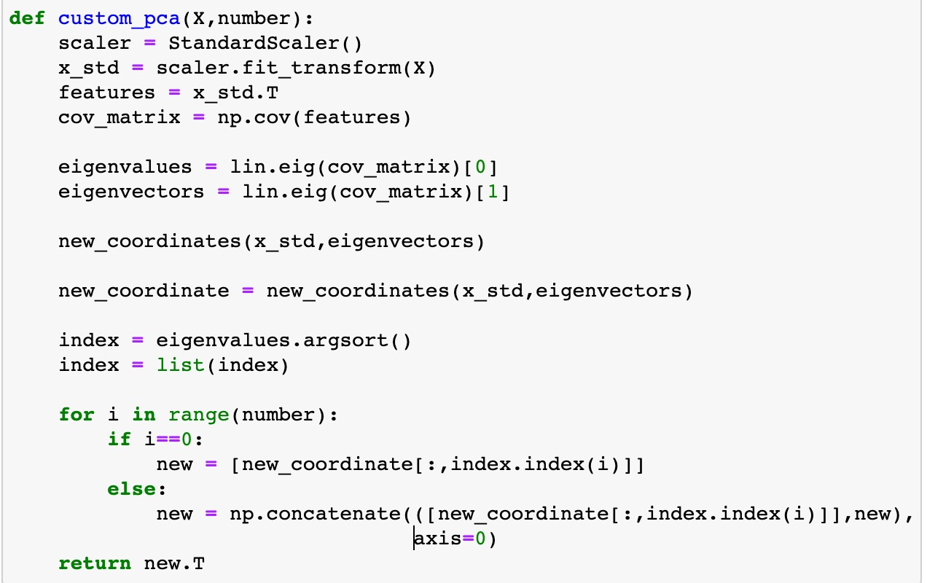
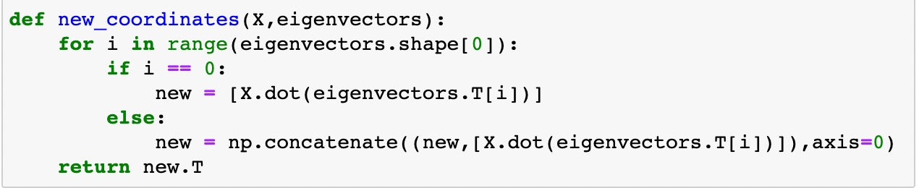
Example

Slide 17
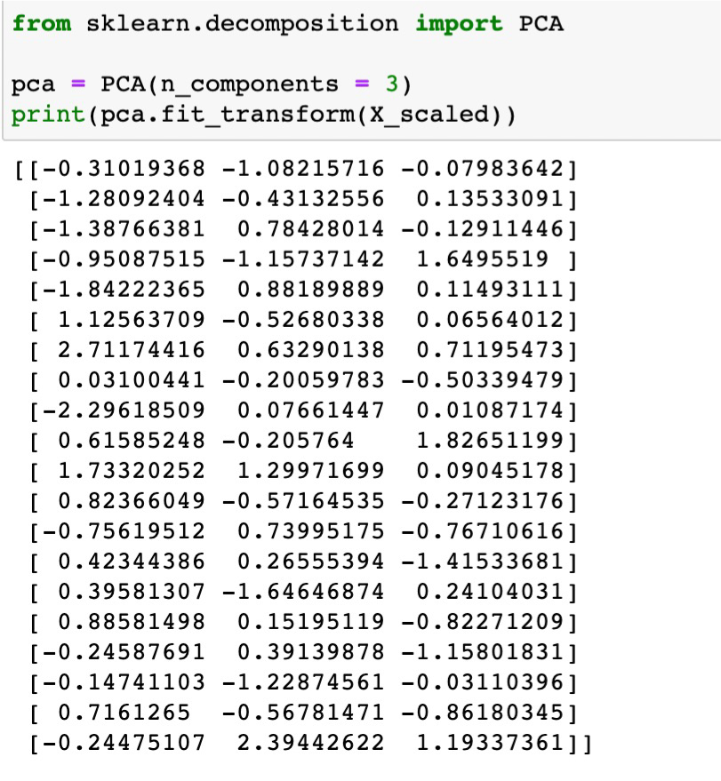
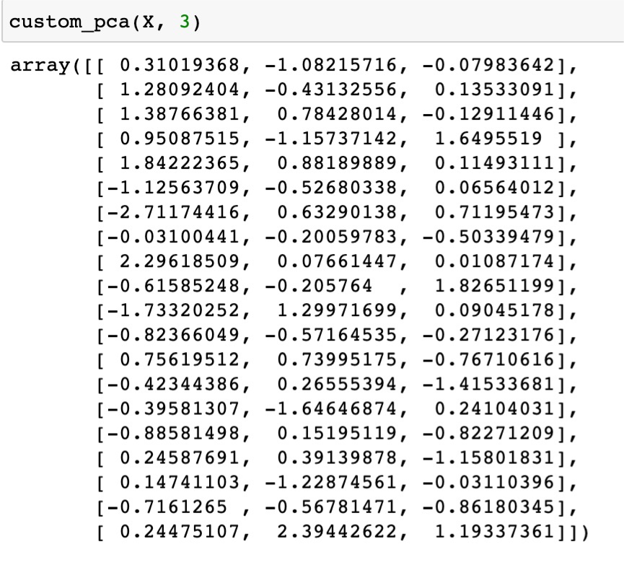
Example

Slide 18
0222 후반부
이준희

Slide 19
목차
Overview
Clustering Metrics
K-Means Clustering
DBSCAN
Project

Slide 20
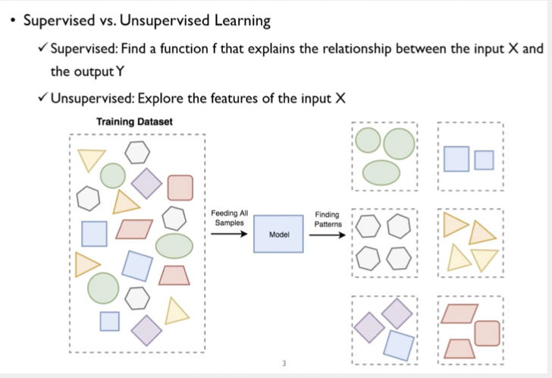
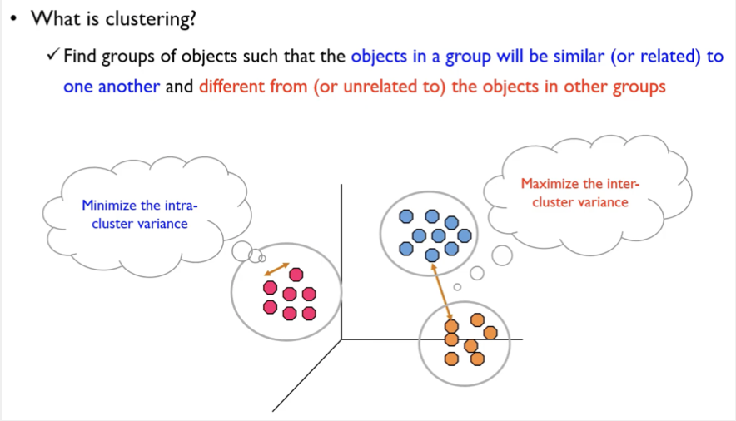
Overview

Slide 21
Contents of Clustering Metrics
Overview
Silhouette Coefficient
Elbow Method

Slide 22
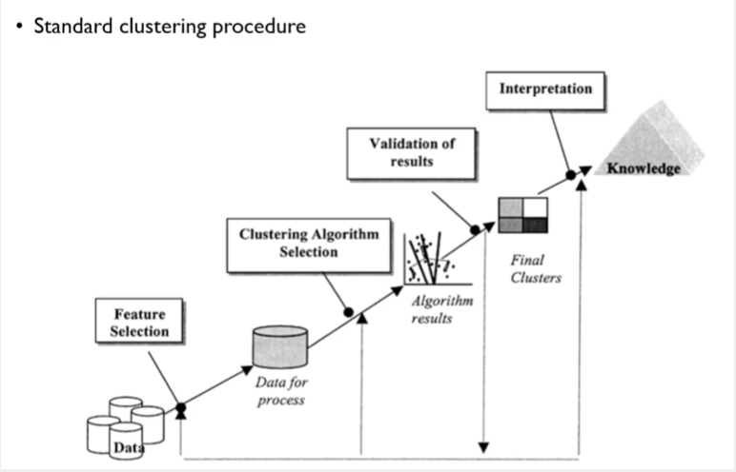
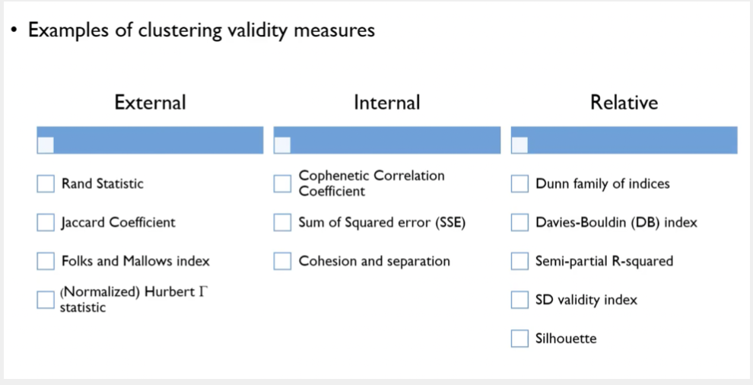
Clustering Metrics - Overview

Slide 23
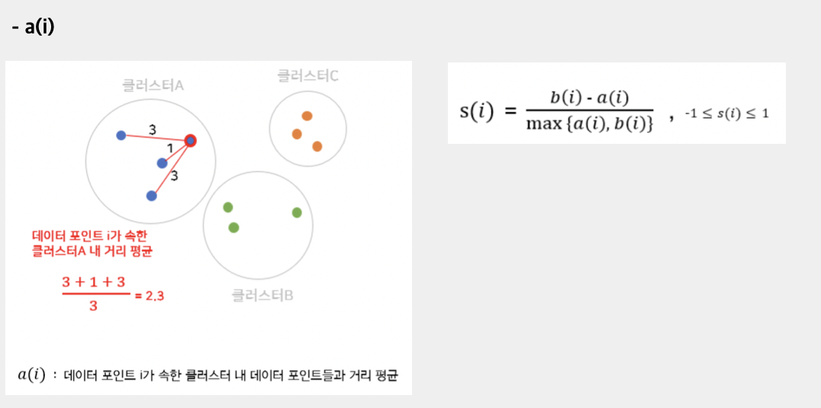
Clustering Metrics - Silhouette Coefficient

Slide 24
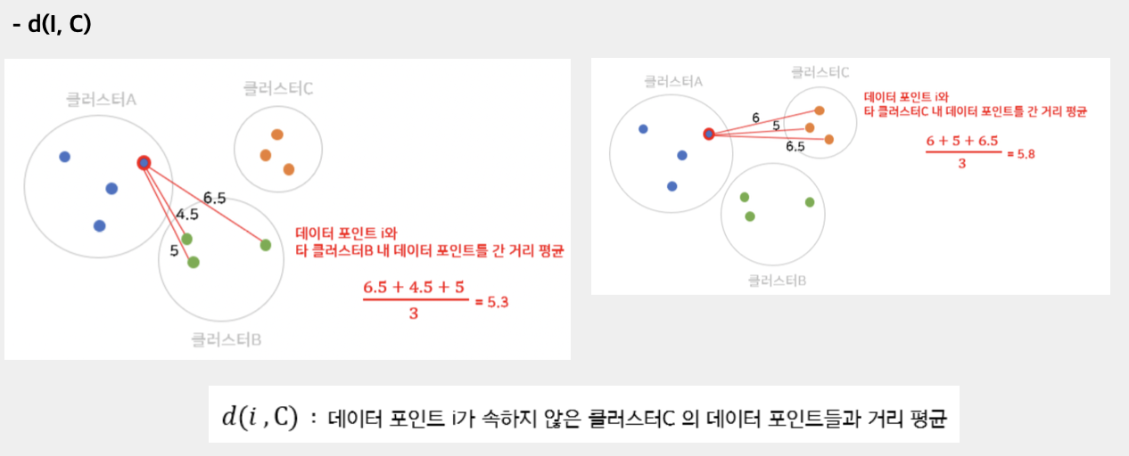
Clustering Metrics - Silhouette Coefficient

Slide 25
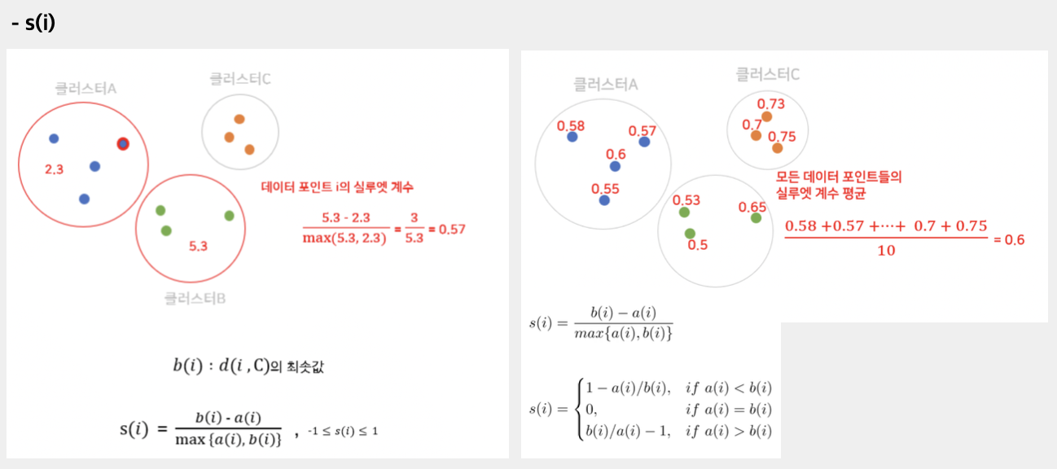
Clustering Metrics - Silhouette Coefficient

Slide 26
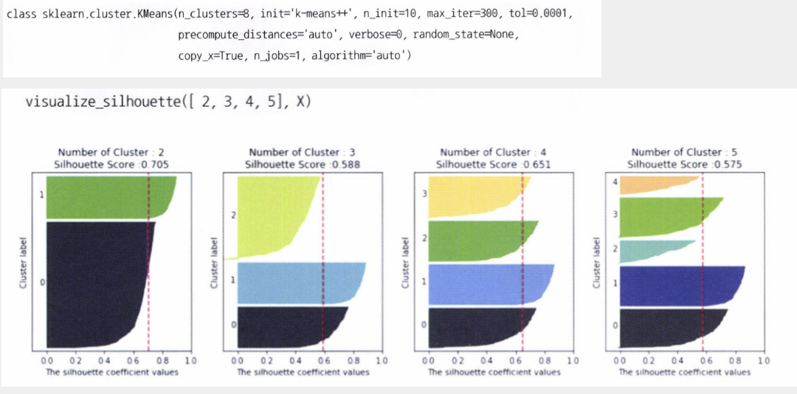
Clustering Metrics - Silhouette Coefficient

Slide 27
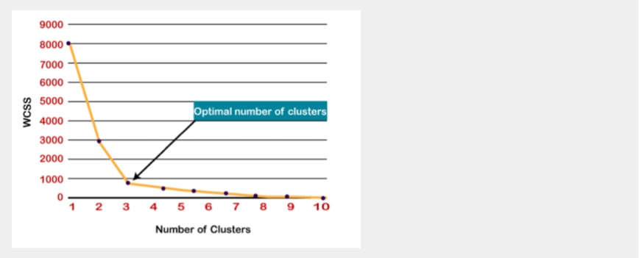
Clustering Metrics – Elbow Method

Slide 28
Contents of K-Means Clustering
Hard vs Soft Clustering
Partitional vs Hierarchical Clustering
Process of K-Means Clustering
Effect of initial centroids
Limitations of K-Means Clustering

Slide 29
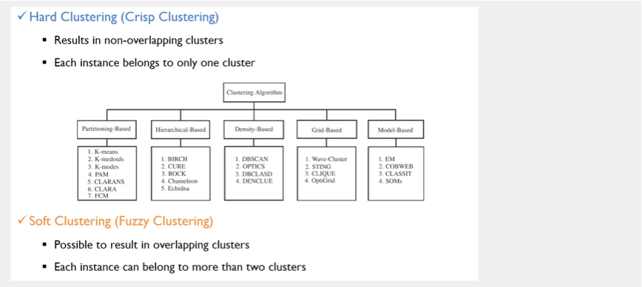
K-Means Clustering - Hard vs Soft Clustering

Slide 30
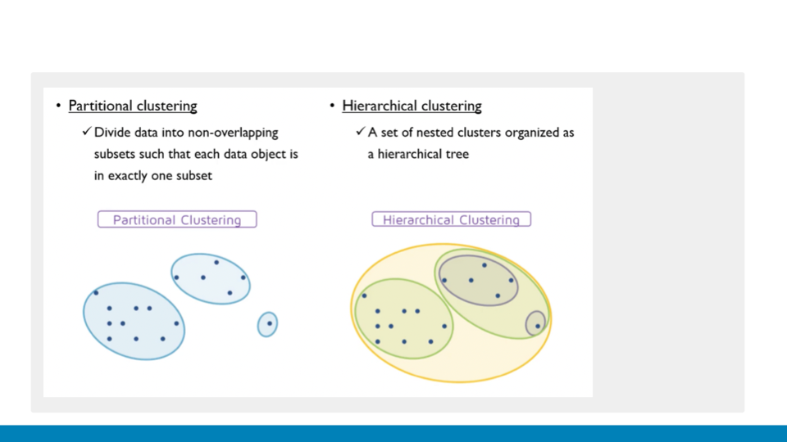
K-Means Clustering - Partitional vs Hierarchical Clustering

Slide 31
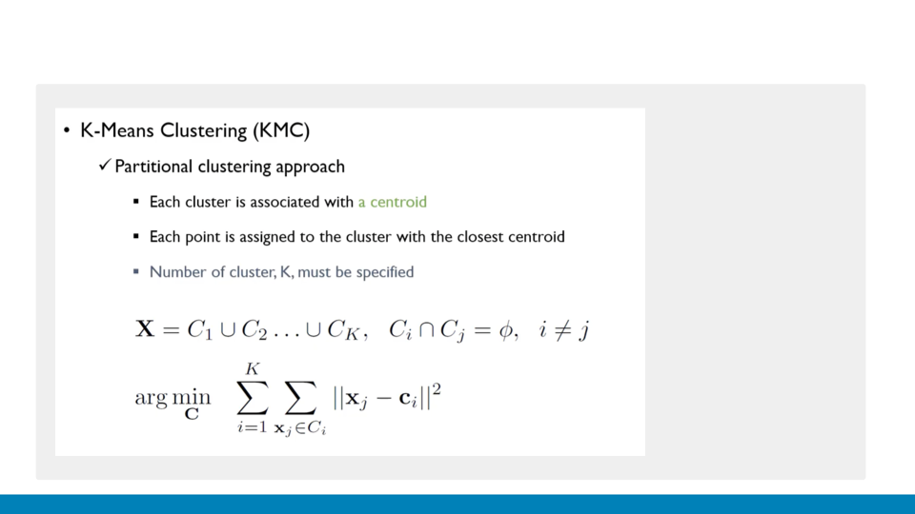
K-Means Clustering - Process of K-Means Clustering

Slide 32
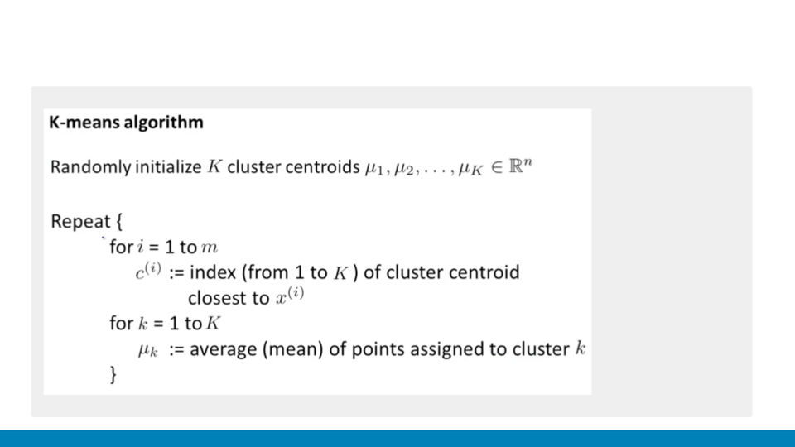
K-Means Clustering - Process of K-Means Clustering

Slide 33
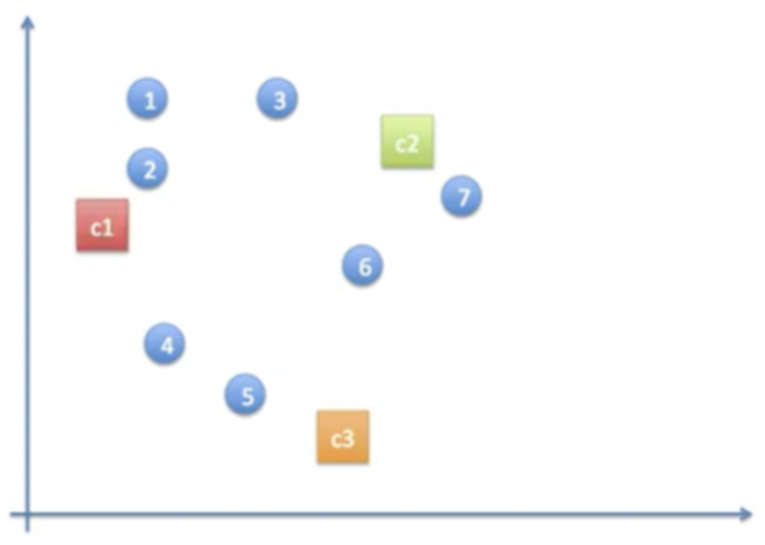
K-Means Clustering - Process of K-Means Clustering

Slide 34
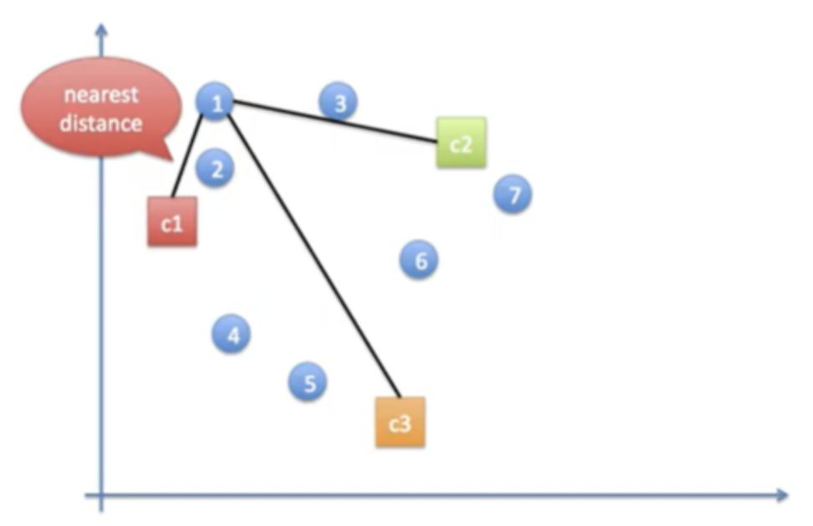
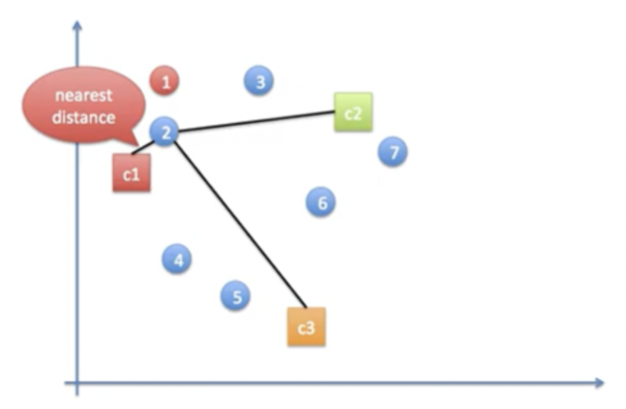
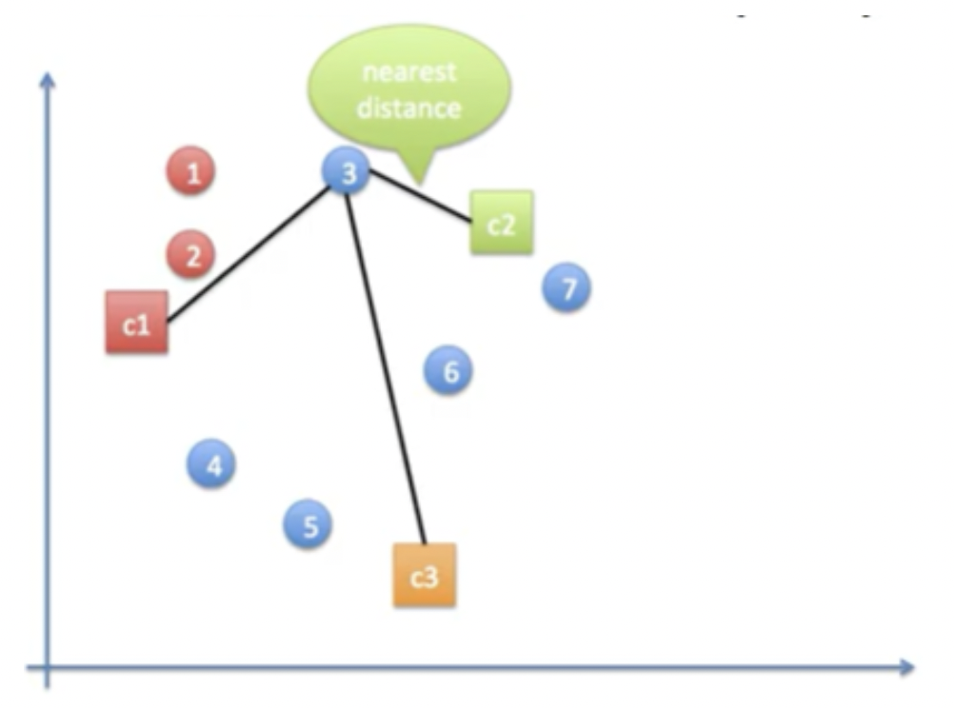
K-Means Clustering - Process of K-Means Clustering

Slide 35
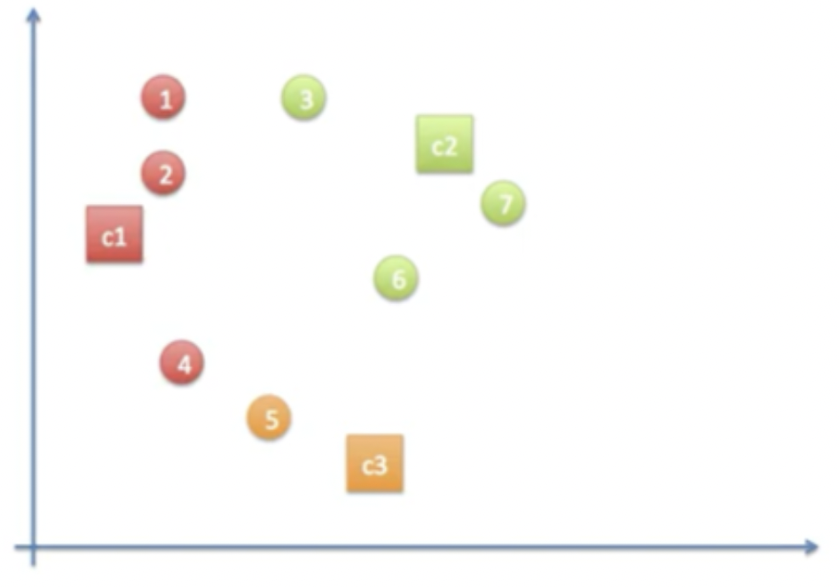
K-Means Clustering - Process of K-Means Clustering

Slide 36
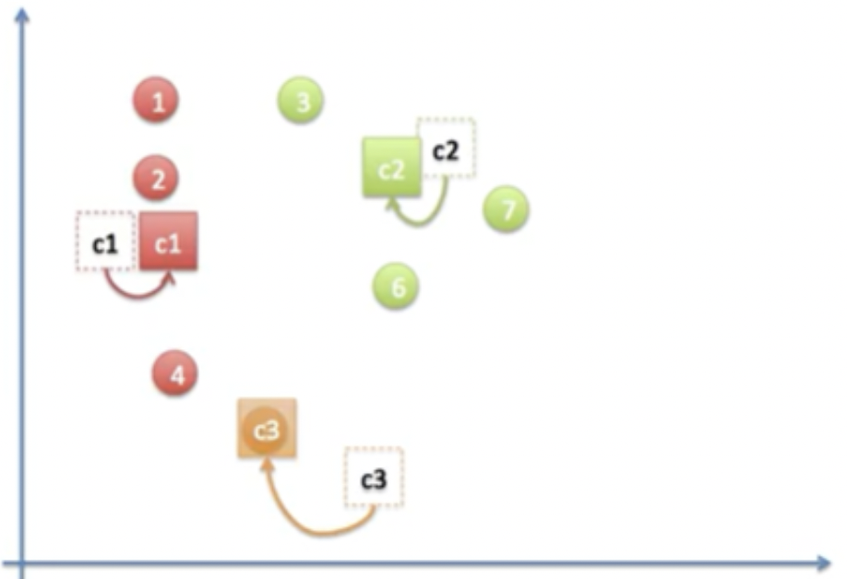
K-Means Clustering - Process of K-Means Clustering

Slide 37
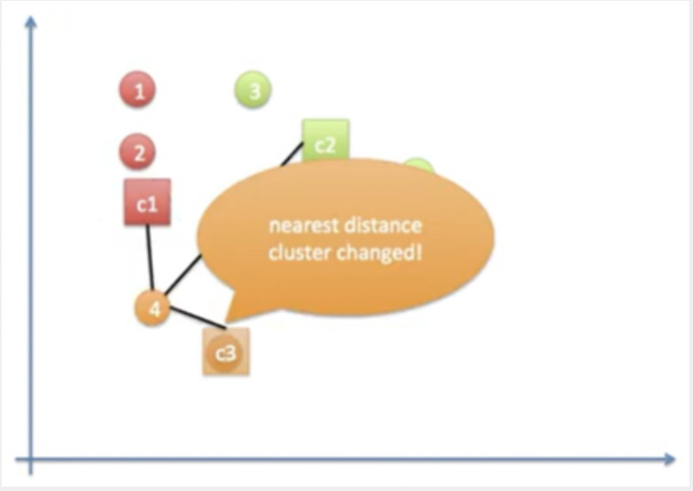
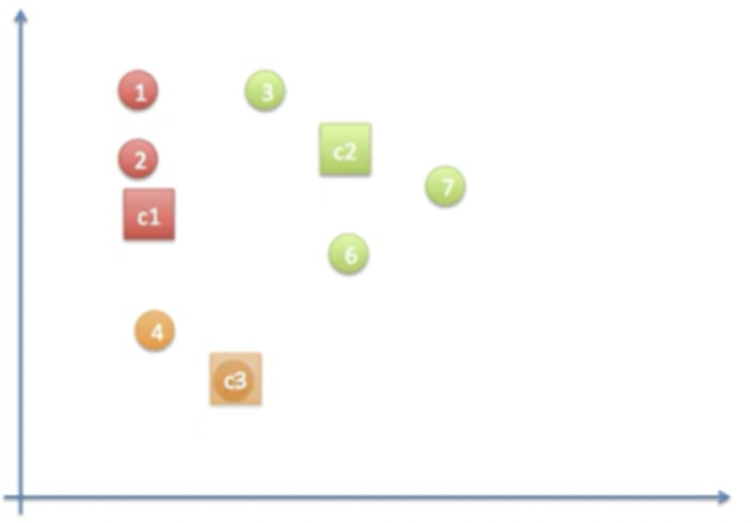
K-Means Clustering - Process of K-Means Clustering

Slide 38
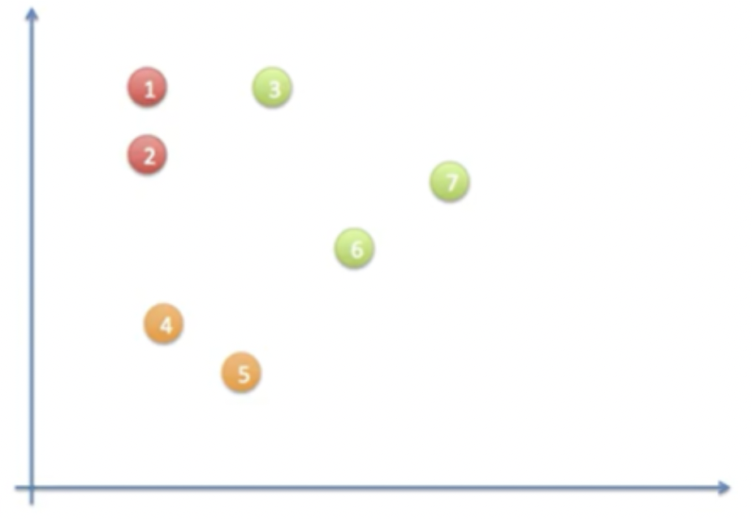
K-Means Clustering - Process of K-Means Clustering

Slide 39
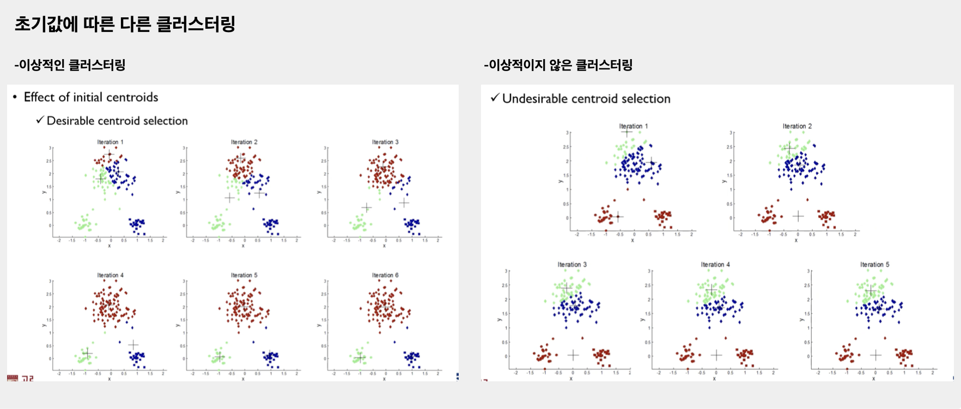
K-Means Clustering – Effect of initial centroids

Slide 40
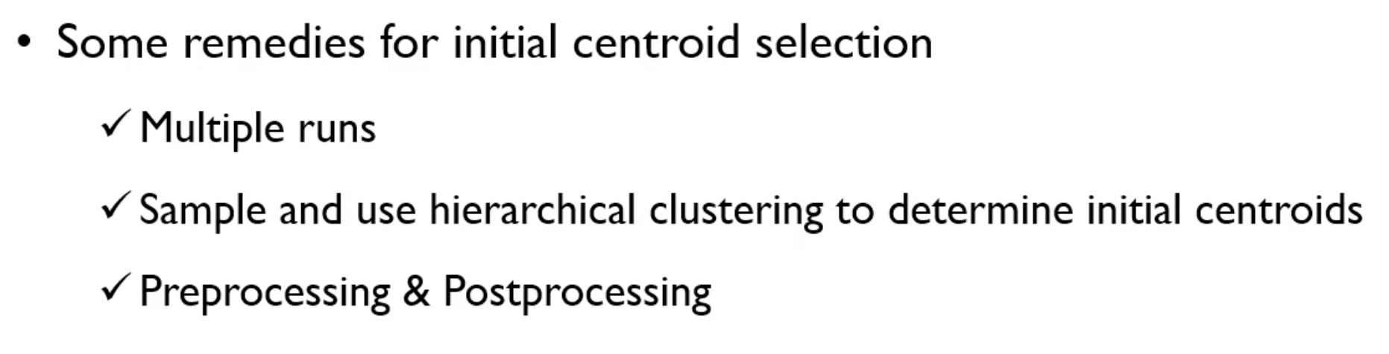
K-Means Clustering – Effect of initial centroids

Slide 41
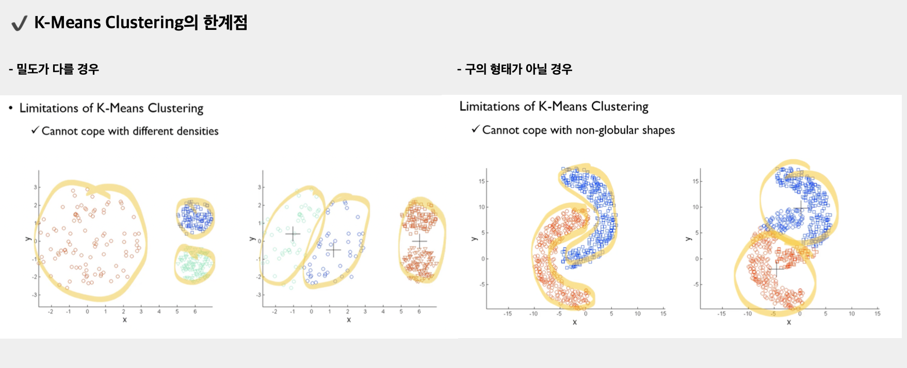
K-Means Clustering – Limitations of K-Means Clustering

Slide 42
DBSCAN
Overview
Epsilon
Border Point
Definition of DBSCAN

Slide 43
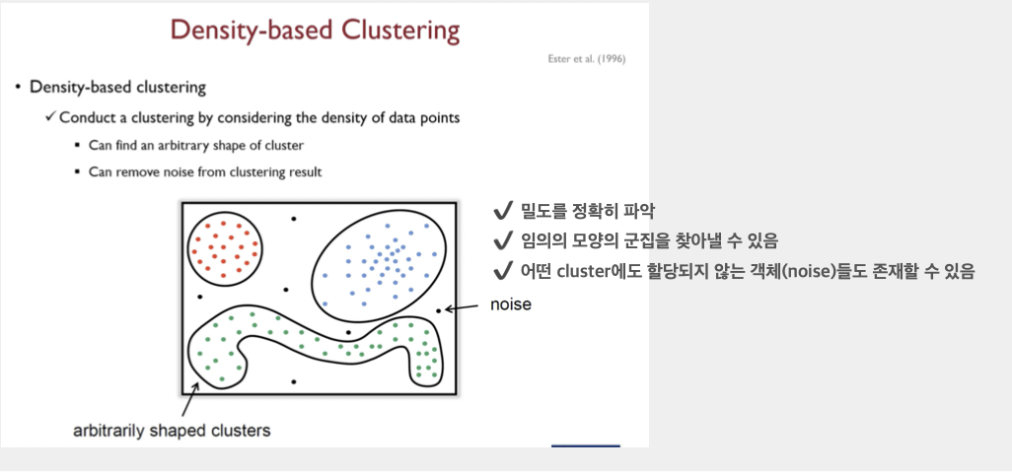
DBSCAN - Overview

Slide 44
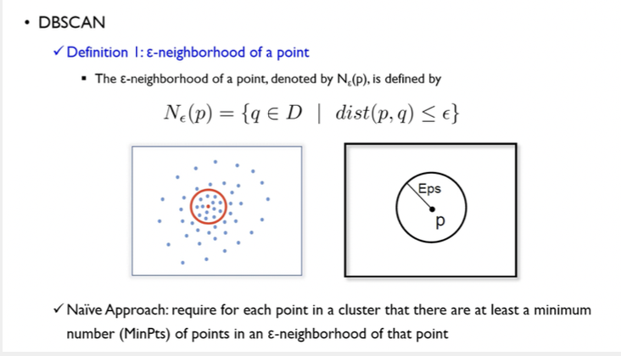
DBSCAN - Epsilon

Slide 45
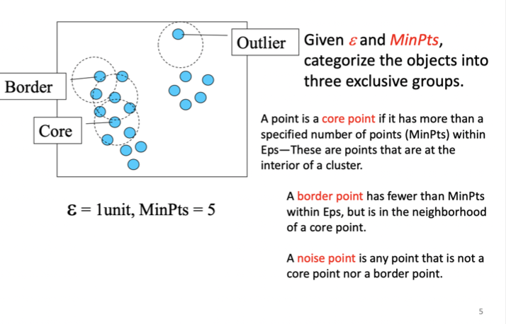
DBSCAN – Border Point

Slide 46
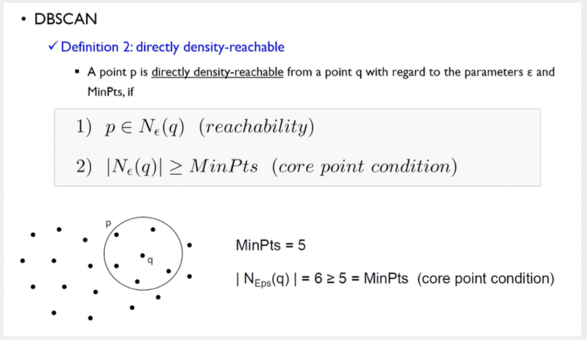
DBSCAN – Definition of DBSCAN

Slide 47
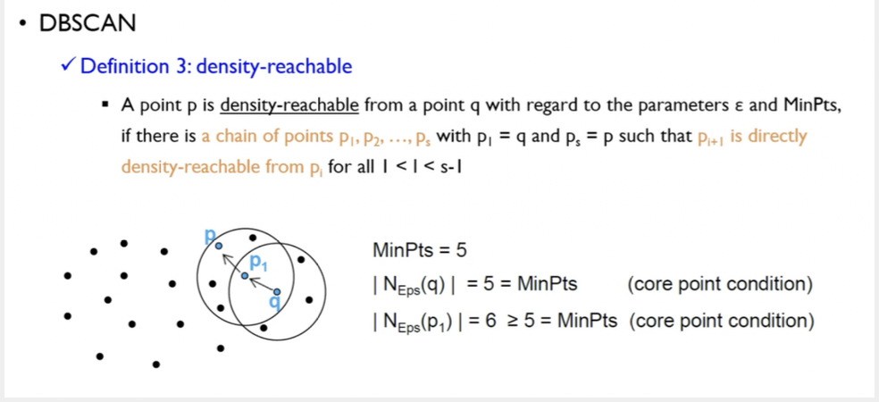
DBSCAN - Definition of DBSCAN

Slide 48
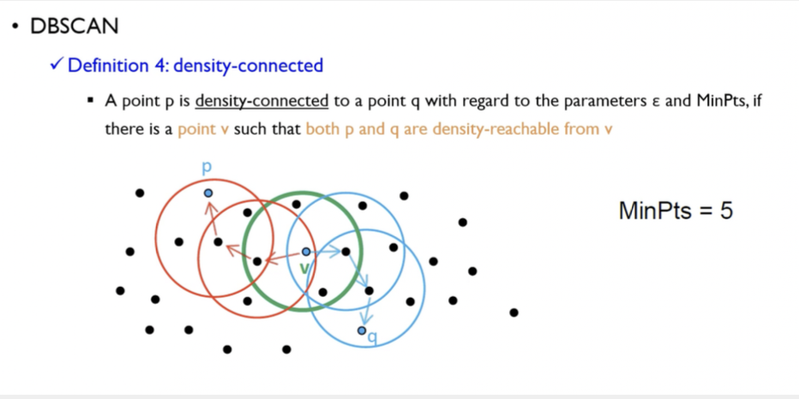
DBSCAN - Definition of DBSCAN

Slide 49

DBSCAN - Definition of DBSCAN

Slide 50
Project
Check out for code

